Slide 1
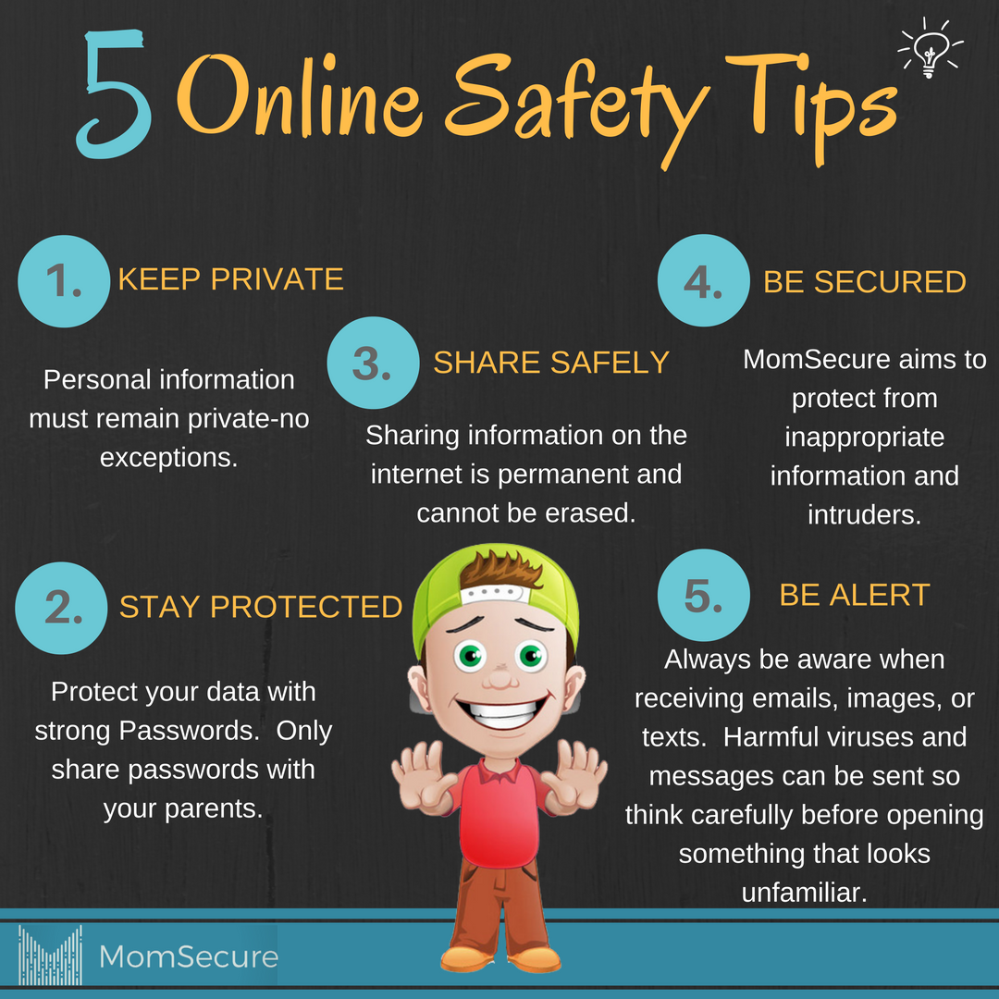
Online Safety for Parents
7th October 2025

Slide 2
Content
Ofcom statistics.
General tips for helping your child navigate the online world.
Imagery and videos.
Gaming and gambling.
Social media: TikTok, WhatsApp
Help is out there – links to resources.

Slide 3
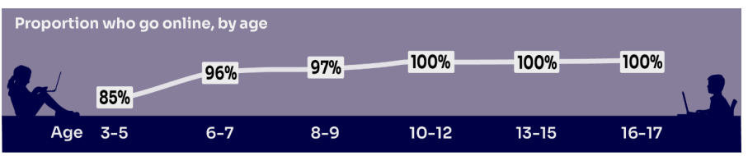
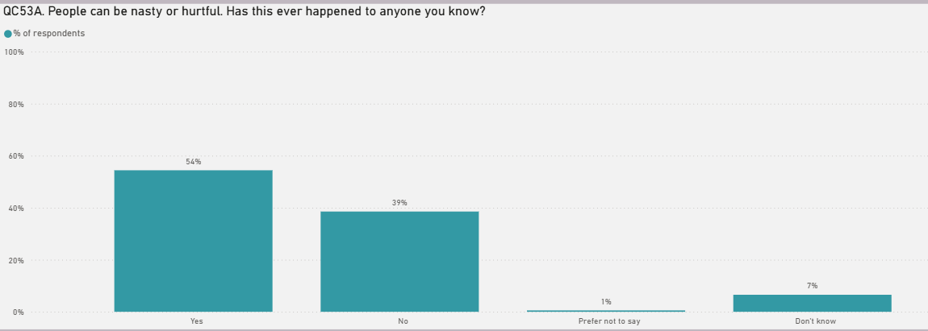
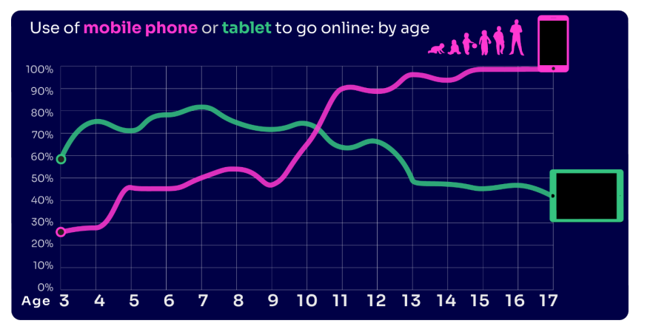
Online safety:
Notes:
Ofcom Statistics – May 2025.
54% of children said that they had experienced someone being nasty or hurtful online. Four in ten 8-17 year olds believe that people are mean or unkind to each other online all or most of the time.
Children's Media Literacy Report 2025

Slide 4
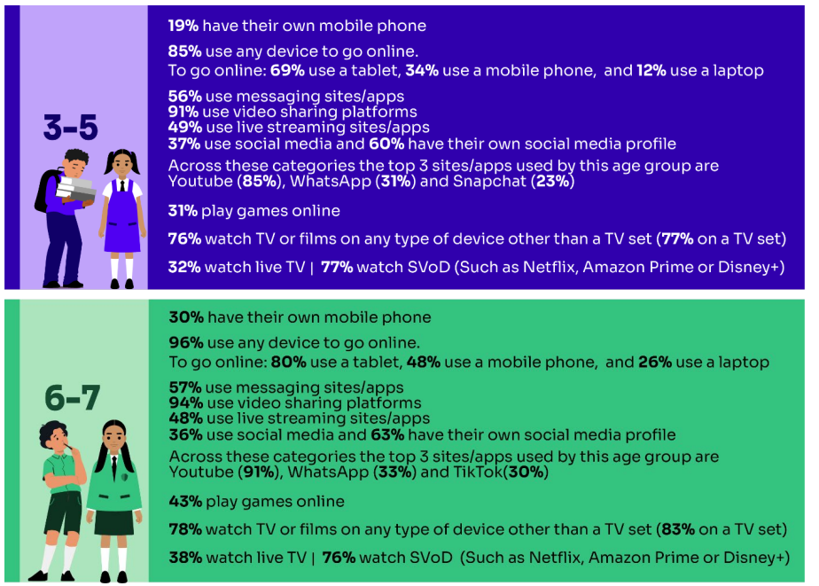

Slide 5
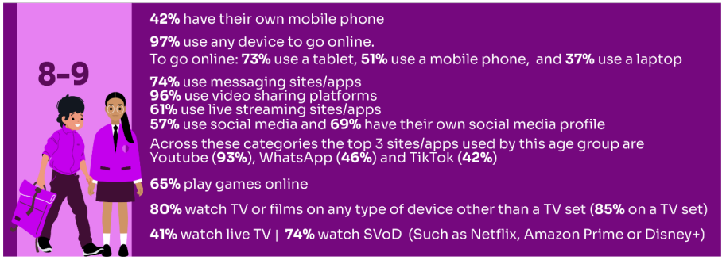
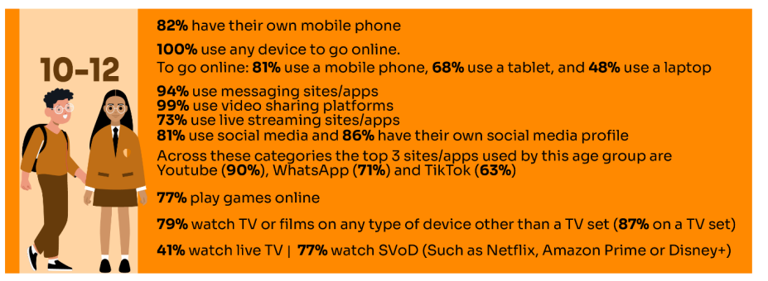

Slide 6
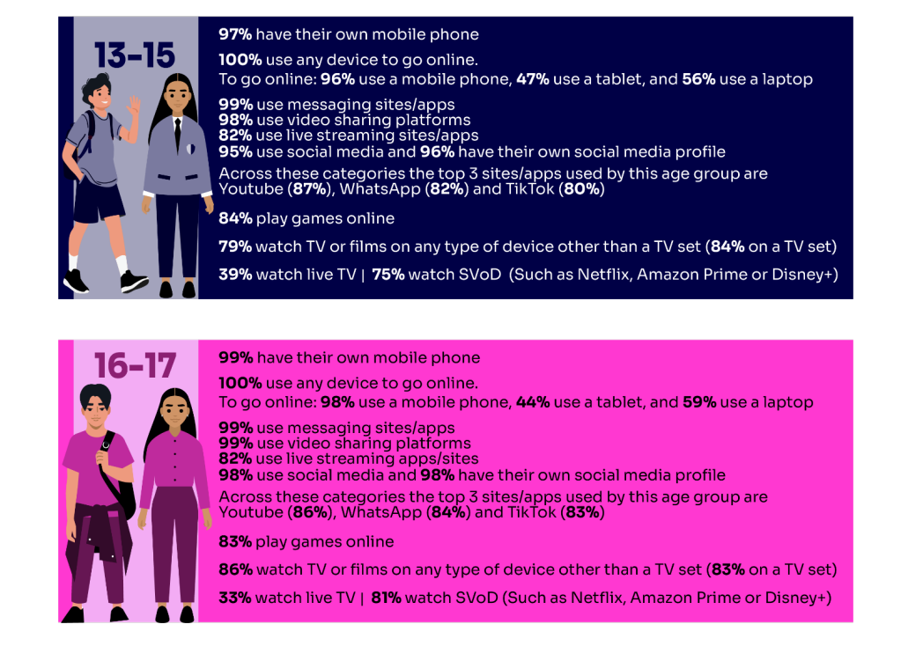

Slide 7
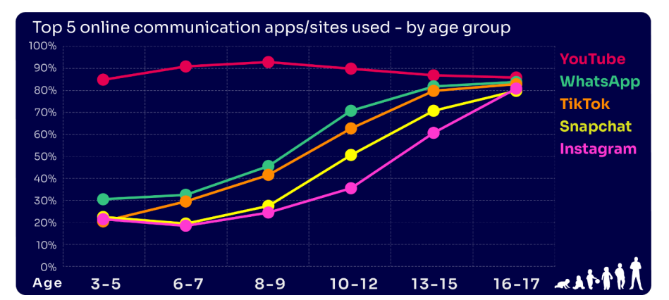

Slide 8
Other stats: Smartphone Free Childhood
89% of 12 year olds have their own Smartphone.
29 hours per week is the estimate of how long they spend on their phone.
Teens with problematic (addictive) Smartphone use are 2x as likely to have anxiety and 3x as likely to have depression.
The number of children referred to emergency mental healthcare in England has risen by 53% in 3 years.
Since 2010: 78% rise in self-harm for girls. 134% rise in boys.
This pattern is mirrored for eating disorders, problematic behaviours, and mental health issues.
51% of UK 11-13 year olds have seen hard-core porn.
75% of UK 15 year olds have been sent a beheading video.
280% increase in self-generated sexual abuse imagery that’s been shared in 56 different countries.
Notes:
Statistics from Smartphone Free Childhood so I am not sure of the sample size etc (paediatrician spoke about these stats – Dr Louise Mill) – this doesn’t mean that we have to support this initiative as that is down to individual schools and parents. However, as parents what we do need is to be aware of the impacts of Smartphone use on our children physically, socially and emotionally and like with anything that can be harmful, we educate them about this and protect them while they are too young to understand the risks – or not yet at a developmental stage to understand the risks.

Slide 9

Notes:
So what are general things we can do to keep our children safe.

Slide 10
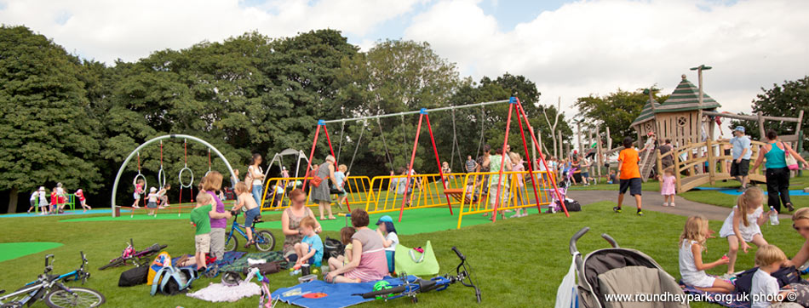
Notes:
Rules! Well, in many ways the response to that is simple – we have rules in the same way that we do in other areas of life. What are the rules in the playground? We don’t go off with anyone else, we don’t speak to strangers, we are respectful of others, we think about how we keep ourselves safe on the equipment, we don’t swear at other people, we follow the rules which keep us and others safe.
Although, I do appreciate that when it comes to the online world things are more complicated – but our children need to understand that the rules of being online apply in the same way that we have other rules and it doesn’t matter if their friend has this or that, your rules are what matters and they are there to keep them safe and healthy. We also need to be clear on time boundaries – games can be coercive, so children need to understand that the game stops when the adult says so, not when the game says so.

Slide 11

Tech Role Model?
We are their key influencers!
Model good behaviour:
Be a positive role model by demonstrating safe online practices, such as asking permission before sharing photos and questioning the information you encounter.

Slide 12
Tech Role Model?
When talking to children don’t use your mobile phone.
Turning off notifications to avoid that constant ‘ping’
Using an alarm clock so you don’t have electronic devices in your bedroom
Keeping your phone on silent in your pocket or bag when you are with the children
Times in the day when phones are not being used. For example at meal time.
Tech free days
Notes:
Doing these things shows children balance in our use of technology – we can use it positively and to enhance our lives, but we don’t need to be dependent ton it, or pay more attention to it than we do other human beings.

Slide 13
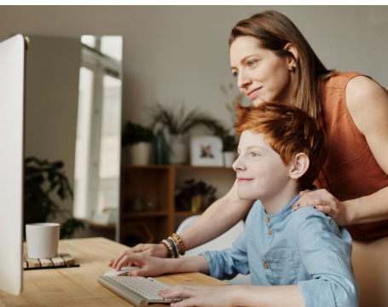
Communication
Start early about online safety.
Create a safe space so they can talk about worries, upsets or confusing content.
Reassure them they can speak to you – especially if they have made a mistake.
Notes:
Start the conversation early:
Begin discussing online safety topics as soon as children start using the internet to build healthy habits. Create a safe space where your child feels comfortable telling you if they encounter anything online that worries, upsets, or confuses them. Reassure them that they can talk to you about anything and that if they do make a mistake, they still need to talk to you so that you can help them to put it right.

Slide 14

Safeguards – help them understand the rules
Levels of privacy
Every social media’s default setting is fully public – Facebook, TikTok, WhatsApp, Instagram, Snapchat. Bear in mind age ratings…they are there for a reason.
Passwords don’t share yours – model the importance.
Don’t give away personal information – what can we share and what can’t we share and why.
Use parental controls on devices to ensure your child is protected from online harm.
Until you think your child is mature enough to deal with the Internet; restrict access.
Separate accounts – the content you look at will be different to what you want your child to look at.
Notes:
Adjust privacy settings:
Review and update privacy settings on social media and apps to control who can access your child's information.
But we also need to teach them and keep reaffirming what they do to keep themselves safe. Ensure your child uses strong passwords and never shares them, and consider requiring a passcode for in-app purchases.

Slide 15



Healthy balance, healthy habits
Notes:
Establish clear rules:
Set clear expectations and boundaries for technology use, just as you would for other areas of your child's life.
Supervise younger children:
Physically supervise younger children's online activities and place computers in common areas of the home. Think carefully about the use of headphones – how do you know what is being said to them or what they are listening to.
Promote balanced online and offline activities:
Encourage a healthy mix of online and offline activities to foster well-rounded development.

Slide 16

Setting Boundaries
Set limits on the amount of time your child spends online – set timings
Make sure the child takes regular screen breaks
Make sure the child thinks before they share pictures or videos online
Make sure the child thinks carefully about what they write before they post it online
Make sure the child doesn’t give out personal details to people they don’t know and trust
Limit inappropriate and block illegal material
Make sure the child knows to come to a trusted adult if they are concerned about something
Monitor activity
Sometimes things go wrong – Falling in the playground? Ensure that the children know who to go to if they need picking up?
Notes:
Set limits on the time they are online: this is important for them physically as well as socially and emotionally.
Screen breaks: opticians are now saying that children’s eyesight is being impacted heavily by online behaviour – their long distance vision is diminished and they can have other difficulties associated with not blinking!
Talk to them about behaviour online – the message the children have had is that if they don’t want you, their teacher, their grandparents to see it, it’s not for posting!
Limit inappropriate material – this may sound strange as why wouldn’t you just block it – but it may be that, like a film, you make a decision that the content is appropriate for that particular item….but not generally.
Monitor activity – it is really important and there are parent apps that allow you to clone your child’s phone or family controls that allow you to see what they see and control length of time online.

Slide 17

Cyber bullying - what protection? Advice for parents
Offer reassurance and support. Don’t be afraid to ask questions. Try not to respond with emotion.
Tell the child that if they are being bullied to always keep the evidence
Block the bullies
Learn how to report and where to go for further support (to the platform itself, to CEOP if it’s sexual, police, school, Report Remove to have content taken down)
Talk to the children about friends and followers online.
Encourage them to move away.
Notes:
Try not to respond with emotion: as parents we obviously want to protect our child. You can be angry that someone has bullied your child, but be careful not to catastrophise and make the bully more powerful than they are. We can attune to our children and say the behaviour is wrong, the bully clearly has their own issues, and it will be dealt with appropriately.
Keep the evidence of the bullying – this ensures there can be consequences and follow up.
Block them, leave the chat, move away – I would liken this to the fact that we wouldn’t stay in a room where someone was being rude and abusive to us – we would choose to leave, so we need to talk about that with our children. And not seek out the negative or nasty behaviour – e.g. – there are sites that ‘rate’ or comment on teachers. Most teachers will never look at that….it may be nice to get positive comments, but why also expose yourself to nasty comments – especially if the person hasn’t addressed their concern with you if you have upset them!

Slide 18
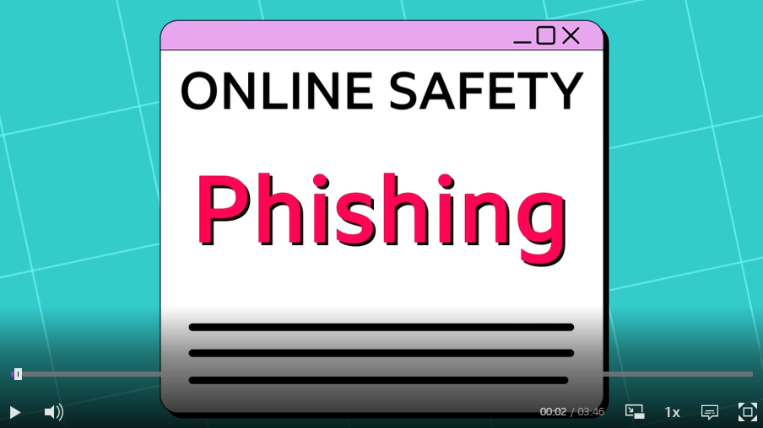
Notes:
Safer Internet Day resources for 7-11-year-olds – on the topic of 'phishing'. - BBC Teach
Talk to your child about phishing and how to be alert to it

Slide 19

Gaming: How can YOU GET INVOLVED?
ASK what type of games your child enjoys – are they age-appropriate?
PLAY games together - keep the tech in shared spaces rather than bedrooms
TALK about who they are playing with - what information are they sharing?
EXPLAIN what is/isn’t appropriate to share, e.g. personal details to identify them/location
AGREE how they will spend their money online
DISCUSS what they would do if they were bullied online, and what steps to take
DECIDE how long is appropriate to play in one session - how many sessions a day
SETUP these restrictions in parental settings with your child
Visit gaming.lgfl.net for advice and activities to keep them safe
Source: Children and parents: media use and attitudes report 2024

Slide 20

Unwanted Contact
Contact is normally by people they children don’t know
Inappropriate communication or grooming
Talk to your children about only playing or talking to people online who they know in real life.
Also reiterate that they don’t share personal information and must always remember that people aren’t always who they say they are.

Slide 21

Advice
Conversation about acceptable chat
Boundaries and time limits
Keep an eye on other responsibilities
Don’t allow access to your credit card.
Base your decisions on evidence

Slide 22



Have you set up parental CONTROLS/PRIVACY SETTINGS for ALL DEVICES and NETWORKS?
Controls have to be set up on both the broadband connection AND each individual device
These do not come as standard so it’s worth checking
They are important because they allow you to:
  Block and filter upsetting or inappropriate content or sites
  Plan what time and how long your child can go online for
Notes:
TELL – it is important that these controls are set up on BOTH the broadband connection AND each individual device
About seven in ten (73%) parents of all 3-17-year-olds use at least one type of technical tool or control to manage their child’s access to online content; parents of 8-11-year-olds are more likely than those of older children to use at least one of these tools (84% vs 70% of parents of 12-15s and 54% of parents of 16-17s respectively). The most commonly-used technical tool used, across all parents of 3-17s, were parental controls built into the device by the manufacturer, e.g. Windows, Apple, Xbox, PlayStation etc. (32%). (Ofcom 2024)

Slide 23


REMEMBER
As children get older, restrictions and controls you use will change, but only at a pace you feel is appropriate for your child, not pressure from your child “because everyone else is allowed”
Content filters are never 100% effective, at some point your child may come across inappropriate or upsetting content, so make time to talk regularly

Slide 24











Imagery and videos
Notes:
Children have access to a whole range of platforms on which they can post imagery and videos. It is really important that we talk to them about the imagery they see and whether it is ‘true’ or not.

Slide 25
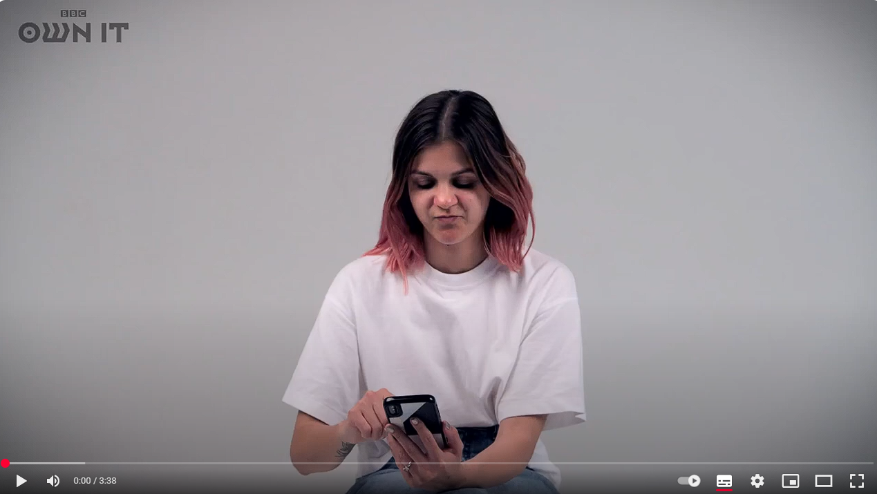
Should we edit our selfies?
Watch the video and think about what advice you would give your friends about editing selfies?
This has been discussed with Year 5 and 6 today.
Notes:
Should we edit our selfies? - BBC Teach

Slide 26
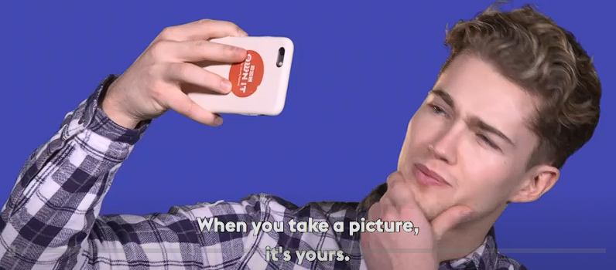
Staying in control of your images
Notes:
How to stay in control of your images - BBC Teach

Slide 27


Slide 28


Slide 29

Shug

Slide 30


Slide 31


Slide 32


Slide 33
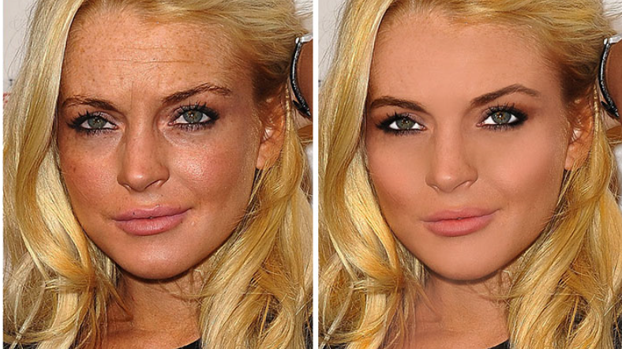

Slide 34

Notes:
What we are trying to teach our children is to be critical thinkers about what they see or hear on the internet. Not everyone is who they say they are. Not everything people say is true. Not every image is the real picture. We need to model to them the idea of being critical consumers of information.

Slide 35

Digital Footprint
The trail that is left behind when you go online
Internet search of what data is publicly available
Notes:
Its also important that young people think about their digital footprint.

Slide 36

Gaming

Slide 37
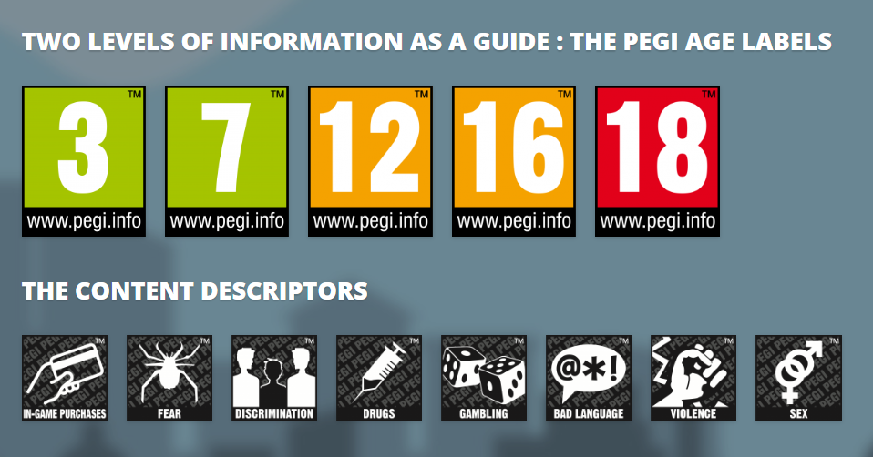
PEGI helps parents to make informed decisions when buying video games:
The age rating confirms that the game content is appropriate for players of certain age
It considers the age suitability of a game, not the level of difficulty
pegi.info
Notes:
UK uses the PEGI (Pan European Game Information) system to give games their age ratings to help people make informed decisions when buying video games or apps through the use of age recommendations and content descriptors. .You can find out more here: https://parentzone.org.uk/article/pegi-games-ratings#:~:text=The%20UK%20uses%20the%20PEGI,about%20how%20PEGI%20classifies%20games.

Slide 38
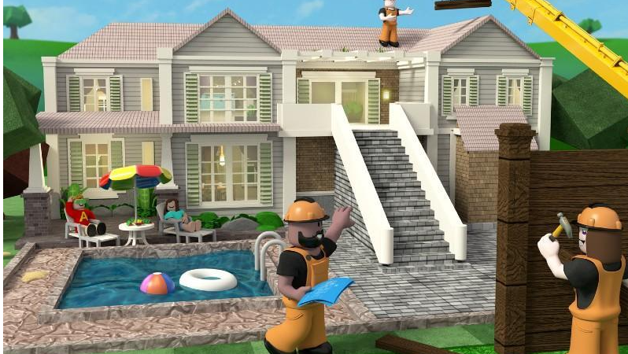
ROBLOX

Slide 39

Why is it popular?
Roblox is the ultimate virtual universe that lets you create, share experiences with friends, and be anything you can imagine.
Roblox - vast quantity of games for children of all ages and making their own games.
Games evolve quickly from player feedback. The result is not only finely honed challenges, but also a sense of fun and freedom often absent from the commercially designed experiences elsewhere.
For many children, Roblox will be one of the first places where they interact online with other people, whether via the platform’s in-game chat options or by adding ‘friends’ and sending them messages.
Notes:
Blue circle – what Roblox says about itself.

Slide 40

What do parents need to be aware of?
In game purchases – Robux, but can also subscribe to get 450 Robux a month (using real money!).
In game chat (can be restricted)
Parental controls
  Parents need to set up an account
  Parents should specify the age of the child – settings for under 13s can then be applied.
  PEGI rated 7, but the content created by other game users may not be this age-rating – so setting the control is important.
Reporting and blocking functions – individuals and games.
Notes:
Spending is encouraged as a proportion of the ‘money’ goes to the game creator.
Roblox uses an in-game text-chat. This content is monitored to ensure no personal details or inappropriate language is used, making it a good way for your child to get used to the concept of public chats, but in a relatively safe space. There is a risk that children could be encouraged to chat with players outside of this moderated chat. Remind them that doing so could put them in danger, as other platforms may not have the same level of moderation.
The privacy settings enable you to specify how the player interacts with other people they don’t know, such as who they can message and who can contact them. It can also be used to restrict access to private games.

Slide 41

Notes:
A battle royale game is a genre of online multiplayer video game where dozens or hundreds of players are pitted against each other, with the goal being to be the last person or team alive. Players start with minimal equipment and must scavenge for weapons and supplies, while a shrinking "safe area" on the map forces confrontations. The last player or team remaining wins the match.
Fall Guys is a type of Battle Royale game, but without fighting/hurting other people.

Slide 42
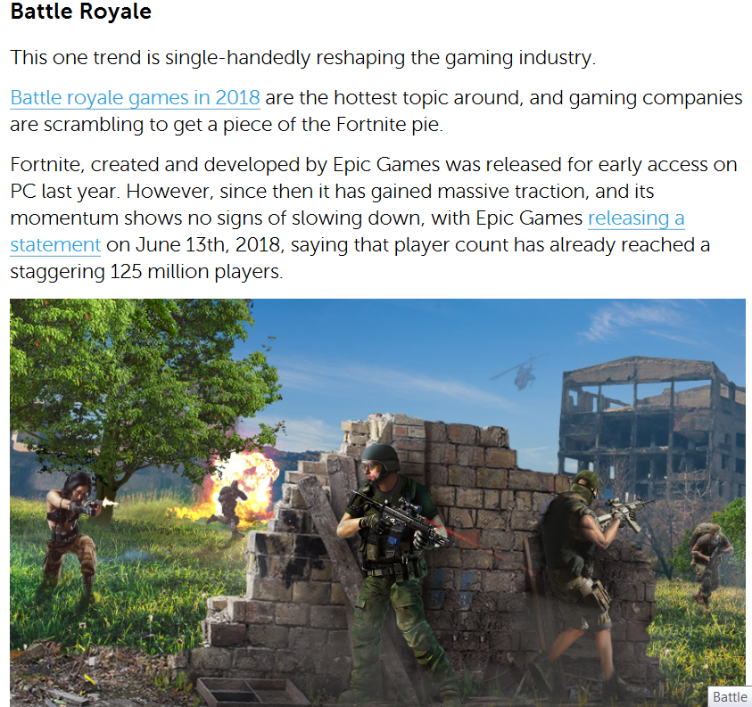
Notes:
A Battle Royale is a fight between many different people until only one fighter remains standing. A sort of free-for-all.
There is no designated group, and the combatants can use everything in their disposable to achieve victory. Think Hunger Games, and you pretty much got it

Slide 43

Risks:
Addiction
Excessive screen time
Exposure to inappropriate content
Cyberbullying through unmoderated chat interactions
Online predators
Scams
Fortnite Battle Royale – Free
Full version costs money
Age 12
100 people play against each other
Notes:
Parental Controls:
Utilize in-game parental controls to limit chat, purchases, and screen time,

Slide 44

Notes:
Apex Legends has a PEGI 16+ rating in Europe. The PEGI 16 rating reflects sustained depictions of violence against human characters, moderate violence, and elements like chemical gas attacks and finisher moves that execute helpless enemies. Both ratings also consider the online interactions, which include voice chat and in-game purchases.
Players communicate with each other with headphones and mics. This audio interaction is not covered by PEGI ratings, so although the game isn’t rated for profanity, its online nature could expose younger players to offensive language from strangers via the voice or on-screen text chat
As signified in the ratings, the game includes purchases. These purchases range from £7.99 to £79.99. While this money will only unlock cosmetic improvements, it is also a way to gain access to all the playable characters in the game more quickly.
Quitting the game can have a negative impact on teammates – coercive control.

Slide 45

Chat service specifically designed for gamers
Connect with each other using either text, voice or video chat.
Focuses on invite-only, group-based communication.
Completely free to use
14 million players accessing it every day, and a total of 150 million users signed up
Risks:
The dangers of Discord include exposure to inappropriate content (like hate speech and explicit material), risks to privacy and the potential for exploitative interactions from strangers, and the possibility of encountering cyberbullying or online grooming. Because of its open nature, public servers can expose users to unfiltered, and sometimes harmful, communication.
Privacy & Safety Settings:
Access the settings to turn on the \"Keep Me Safe\" option to automatically filter explicit content.
Friend Requests:
Adjust friend request settings to \"Friends of Friends\" instead of \"Everyone\" to limit unwanted friend requests.
Direct Messages (DMs):
Disable the ability for strangers to DM your child by toggling off \"Allow direct messages from server members\" in the Privacy & Safety settings.
Family Centre:
Use the Family Centre to connect with your child's account and monitor their new friends and joined servers.

Slide 46
Safeguards
Don’t give away personal information
Three levels of privacy
  Public – anyone can enter the party
  Friends – where only friends can enter the party
  Private - no one can enter the party except on invitation by the player

Slide 47
Advice
Play the game with the children
Conversation about acceptable chat
Boundaries and time limits
Keep an eye on other responsibilities
Don’t allow access to your credit card.
Base your decisions on evidence
Notes:
Activity – write in the chat what other technologies do your YP use? Lets have a look at some more

Slide 48
Unwanted Contact
Contact is normally by people they children don’t know
Inappropriate communication or grooming
Talk to your children about only playing or talking to people online who they know in real life.

Slide 49



Gambling or Gaming
Similarities and Differences?
This Photo by Unknown Author is licensed under CC BY-SA-NC

Slide 50

Statistics – Internet Matters
37 million people in the UK play games
The UK customer spend on games was around £5.7 billion pounds in 2018
Money made from loot boxes in 2018 was $30 billion
95% of children have played an online gaming
On average, children spend 2 hours per day on games during the week and 5 hours at the weekend
Boys are more likely to spend more time online gaming than girls
Children are twice as likely to talk to friends online, rather than strangers/ people they met through the game
28% of children have bought something in a game without their parents/ carer knowing about it.

Slide 51

Do you recognise this?

Slide 52
Loot Boxes
Loot boxes are mystery bundles of virtual items related to a video game. They can be won by a gamer as a reward or can be purchased with real money. If your child likes to play video games, then chances are they have encountered a feature called “Loot Boxes”.
Popular content creator Danny Aarons admitted he spent over £8000 during the FIFA Team of the Year period.
He only got two of these special cards from the amount of money he spent.
Danny has a huge reach across YouTube with 1.1 million people subscribing to his channel.

Slide 53
46% of children paid for In-Game items or ‘mods’
4% bet with in-game items on websites outside the game
27% paid to open loot box
5% gamers generate half the revenue from loot boxes
12 studies find link to problem gambling behaviour
Gambling Commission 2023

Slide 54

Why do Young People Buy Loot Boxes?
The Action
Surprise/ Suspense
Desire to win rare item
Social
In-Game advantage
Peer Pressure
Influencers
Unfair
Frustration
Trading/ Profit
Notes:
Action – noise, colours, music – like a game show

Slide 55

Notes:
Social media

Slide 56


Age rating: 13+
TikTok users can make their own short videos on the mobile app, and often like to have music accompany their videos. The users have creative control over the videos.
Other TikTok users can ‘react’ to videos they see by filming their responses alongside the original video; or ‘duet’ by making a video alongside another video.

Slide 57

What Parents Need to be Aware of?
Users should be at least 13 years old.
In January – updated privacy setting so that under-16s settings are private by default.
March 2023 – a daily screen time cap of 60 minutes for users under 18.
Privacy settings
  ‘Family Pairing’ – allows parents to control elements of their child’s TikTok account if their child is under 16
  Enable ‘restricted mode’.
Notes:
Note also that standard TikTok accounts (rather than TikTok for Younger Users profiles) will be taken down if moderators suspect that the individual operating the account is under the age of 13. This can be a useful piece of information if you’re trying to resist the ‘pester power’ of younger children – there’s less of a point getting around age restrictions if the account will be taken down anyway.
March 2023: daily screen time cap of 60 minutes introduced which applies to all accounts belonging to users under the age of 18 by default.
TikTok offers its users a range of settings to customise their experience and make it safer for young people, which they refer to as ‘Family Pairing’. These settings allow parents to control elements of their child’s TikTok account if their child is under 16.
Enable ‘Restricted Mode’.
Overall, there’s plenty of choice when it comes to privacy settings – you’re able to control who can see, share, or download your child’s content, even on a video-by-video basis. Visit TikTok’s 'Youth Portal' for more information on how best to do this

Slide 58


What about WHATSAPP?
Do you know the minimum age to use this?
What are the risks?
Unwanted contact | to contact somebody on WhatsApp, all you need is their phone number, which could expose you to unwanted messages or calls
Inappropriate content | messages are end-to-end encrypted which means that the content cannot be monitored. This means that your child could see or hear harmful or upsetting content e.g. pornography or violence.
Location sharing | live location feature means that your child could reveal their current location to others
Cyberbullying | children could be bullied, feel left out or deliberately excluded or removed from groups
Oversharing | privacy features, such as disappearing and ‘view once’ messages, might mean that your child feels safe to reveal private or risky information or images. However, there is always a risk that this could be copied and shared
Notes:
TELL - WhatsApp let users send messages and content to contacts added to their account. To use the service in the UK, users must be 13-years-old or older (as of April 2024. The minimum age for WhatsApp used to be 16)

Slide 59
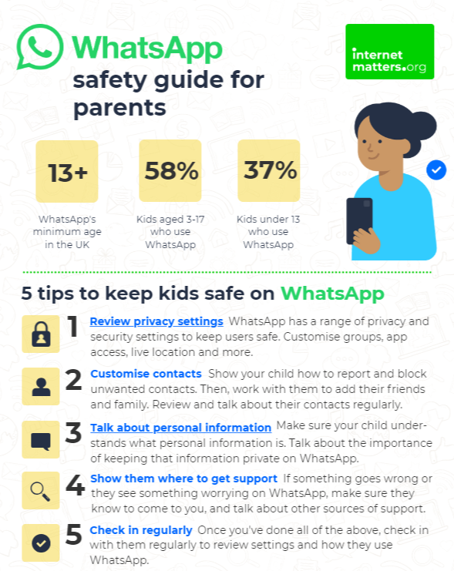
What can you do?
Visit https://www.internetmatters.org/resources/whatsapp-safety-a-how-to-guide-for-parents/#whatsapp-safety-tips for advice for parents
Notes:
SHARE – 5 top tips from the parent safety guide at https://www.internetmatters.org/resources/whatsapp-safety-a-how-to-guide-for-parents/#whatsapp-safety-tips
EXPLAIN – it’s useful to talk with children about etiquette when using group chats e.g.
how to communicate
what language to use/not use
recognition that others may see your messages if copied and shared
what to do if someone is unkind to them or others etc.

Slide 60
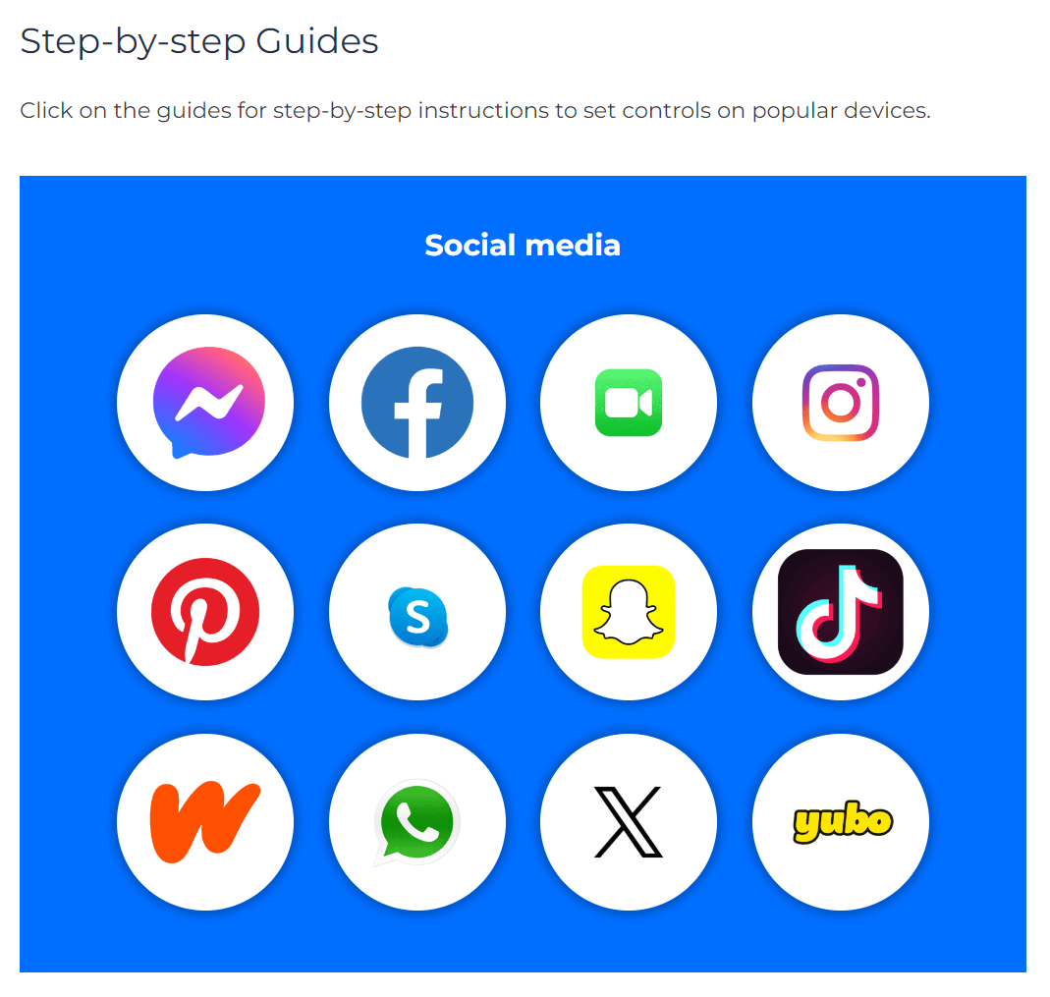
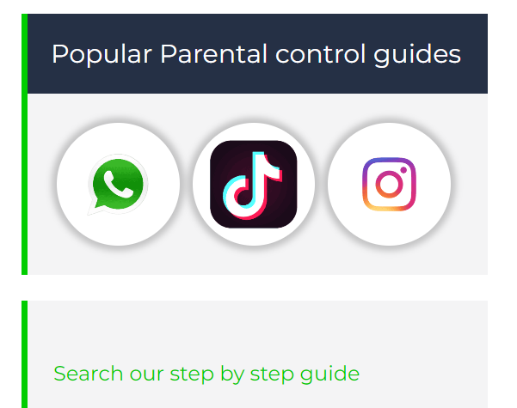
Do YOU know HOW TO REPORT to apps / sites?
Internet Matters has helpful guides for social media apps and sites at internetmatters.org/parental-controls/social-media
Notes:
Each social media site has it’s own processes for reporting inappropriate/harmful content.

Slide 61

What Else?
Setting up separate accounts for the children on the computer
Setting up separate accounts for your child on any mobile devices
Android- setting up a restricted account
  Settings and parental control
Apple – general – restrictions – enable restrictions
Lock in Apps for your children
  Screen pinning on Android
  Guided access on iPhone
Use an App that restricts how long the child spends online
  ScreenTime, netnanny, teensafe
This Photo by Unknown Author is licensed under CC BY-SA

Slide 62
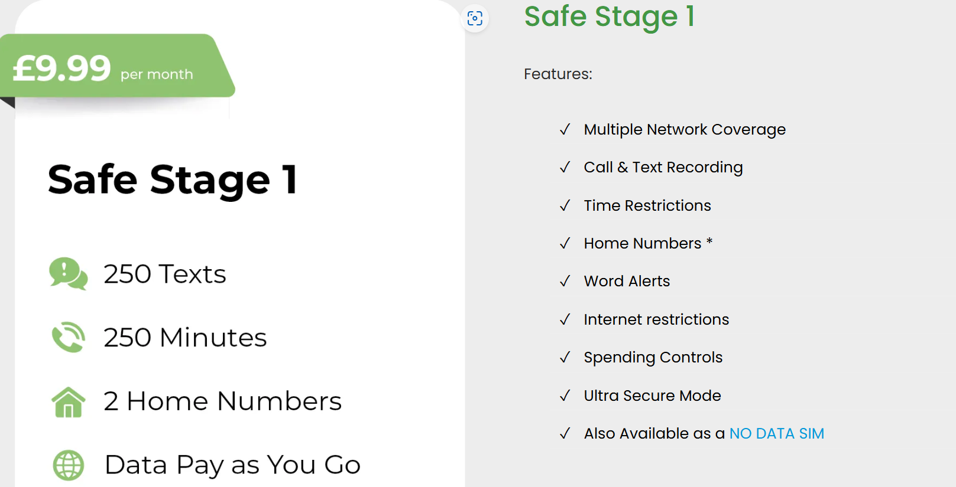
Parent SIM
Notes:
This is an old slide, so prices may change – but a google search will bring up this type of package that parents can use to monitor their child’s phone use.

Slide 63
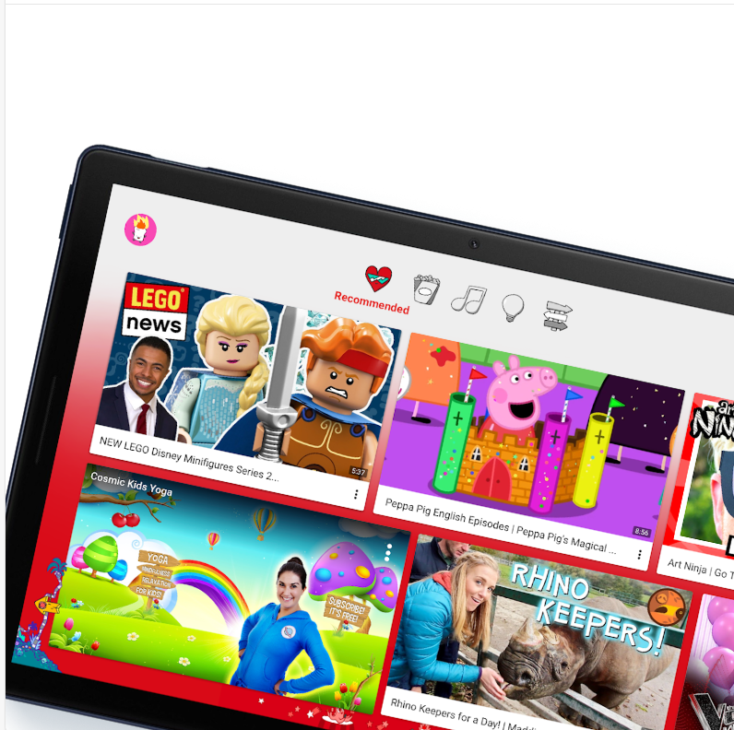
Is YouTube for Kids Safe?
‘YouTube Kids has a much smaller set of content available than YouTube's main app and website. We work hard to keep videos on YouTube Kids family-friendly and use a mix of automated filters built by our engineering teams, human review, and feedback from parents to protect our community.’
YouTube - More Choices for Kids, Tweens, and Teens from YouTube
Is YouTube safe? | NSPCC

Slide 64
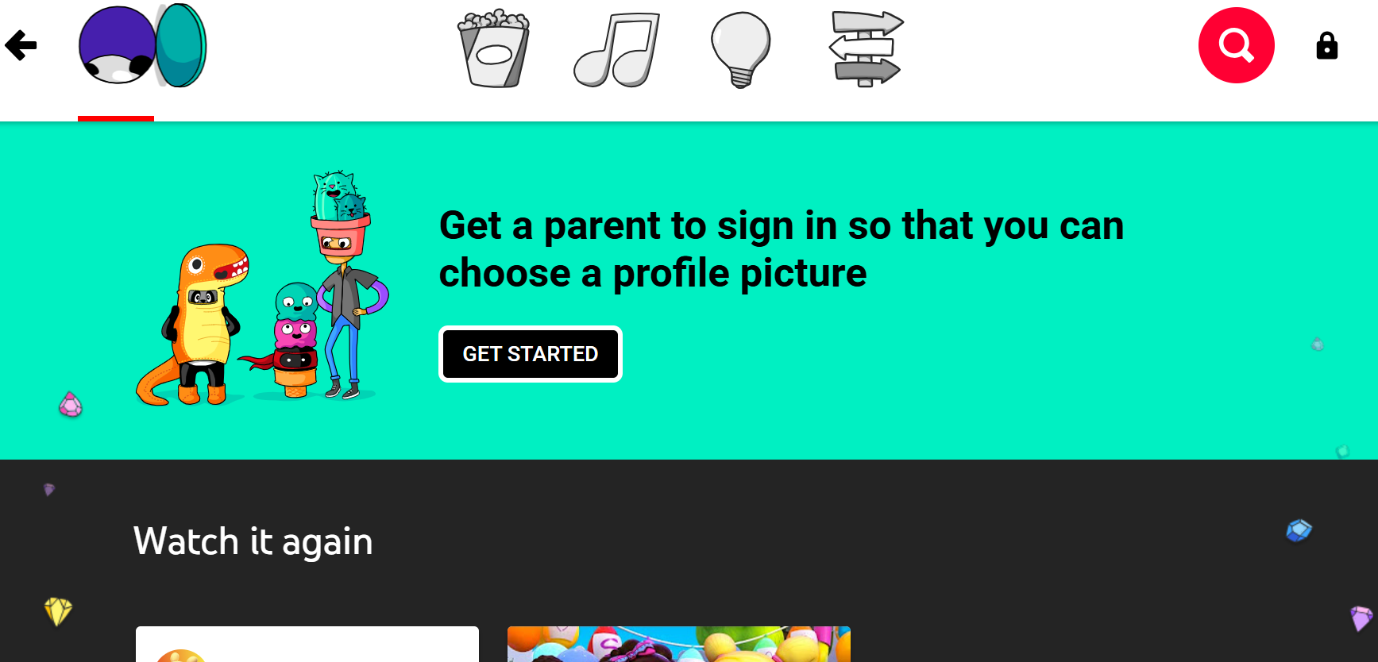
Blocking Content on YouTube Kids
Block & share content on YouTube Kids - YouTube For Families Help

Slide 65

Swiggle
It provides:
  Keyword filtering to stop inappropriate search terms being used
  Google Safe Search filtered results, with a bias towards UK educational resources
  Browser extension to cover your screen if your child finds something inappropriate, through Swiggle or not
  Reporting tools to notify us of any content you think shouldn’t be indexed, or for schools to notify their system administrator to block particular websites
  A friendly character that can guide kids through how to search, report, and customise Swiggle
  Ad-free experience
Notes:
Can use YouTube Kids.

Slide 66
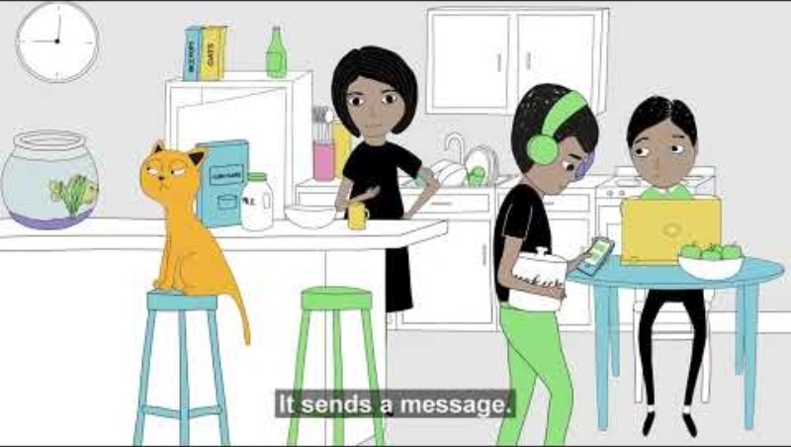
Notes:
Connected Families - Parenting and the internet | Barnardo's (youtube.com)
The "Connected Families - Parenting and the Internet" video by Barnardo's is part of a series aimed at helping parents navigate the challenges of raising children in the digital age. Here are some key points from the video:
Online Risks: The video highlights various online risks that children may encounter, such as cyberbullying, inappropriate content, and online predators. It emphasizes the importance of parents being aware of these dangers to better protect their children[1].
Open Communication: It stresses the importance of maintaining open lines of communication between parents and children. Encouraging children to talk about their online experiences can help parents understand what their children are facing and provide guidance[1].
Setting Boundaries: The video advises parents to set clear boundaries and rules for internet use. This includes setting time limits, monitoring online activities, and discussing what is appropriate to share online[1].
Digital Literacy: It underscores the need for parents to educate themselves and their children about digital literacy. Understanding how to use the internet safely and responsibly is crucial for both parents and children[1].
Support and Resources: The video provides information on where parents can find additional support and resources. Barnardo's offers various tools and guidance to help parents manage their children's internet use effectively[1].
The overall goal of the video is to empower parents with the knowledge and tools they need to create a safe online environment for their children. If you have any specific questions or need further analysis, feel free to ask!
References
[1] Connected Families - Parenting and the internet | Barnardo's

Slide 67
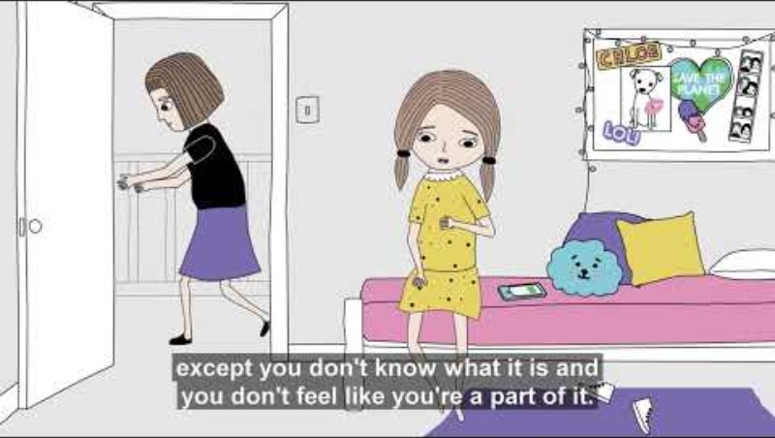

Notes:
Connected Families - Children and the Internet |Barnardo's (youtube.com)
The "Connected Families - Children and the Internet" video by Barnardo's is part of a series aimed at helping parents and children navigate the digital world safely. Here are some key points from the video:
Online Risks: The video highlights various online risks that children may encounter, such as cyberbullying, exposure to inappropriate content, and online predators. It emphasizes the importance of parents being aware of these dangers to better protect their children[1].
Open Communication: It stresses the importance of maintaining open lines of communication between parents and children. Encouraging children to talk about their online experiences can help parents understand what their children are facing and provide guidance[1].
Setting Boundaries: The video advises parents to set clear boundaries and rules for internet use. This includes setting time limits, monitoring online activities, and discussing what is appropriate to share online[1].
Digital Literacy: It underscores the need for parents to educate themselves and their children about digital literacy. Understanding how to use the internet safely and responsibly is crucial for both parents and children[1].
Support and Resources: The video provides information on where parents can find additional support and resources. Barnardo's offers various tools and guidance to help parents manage their children's internet use effectively[1].
The overall goal of the video is to empower parents with the knowledge and tools they need to create a safe online environment for their children. If you have any specific questions or need further analysis, feel free to ask!
References
[1] Connected Families - Children and the Internet |Barnardo's

Slide 68
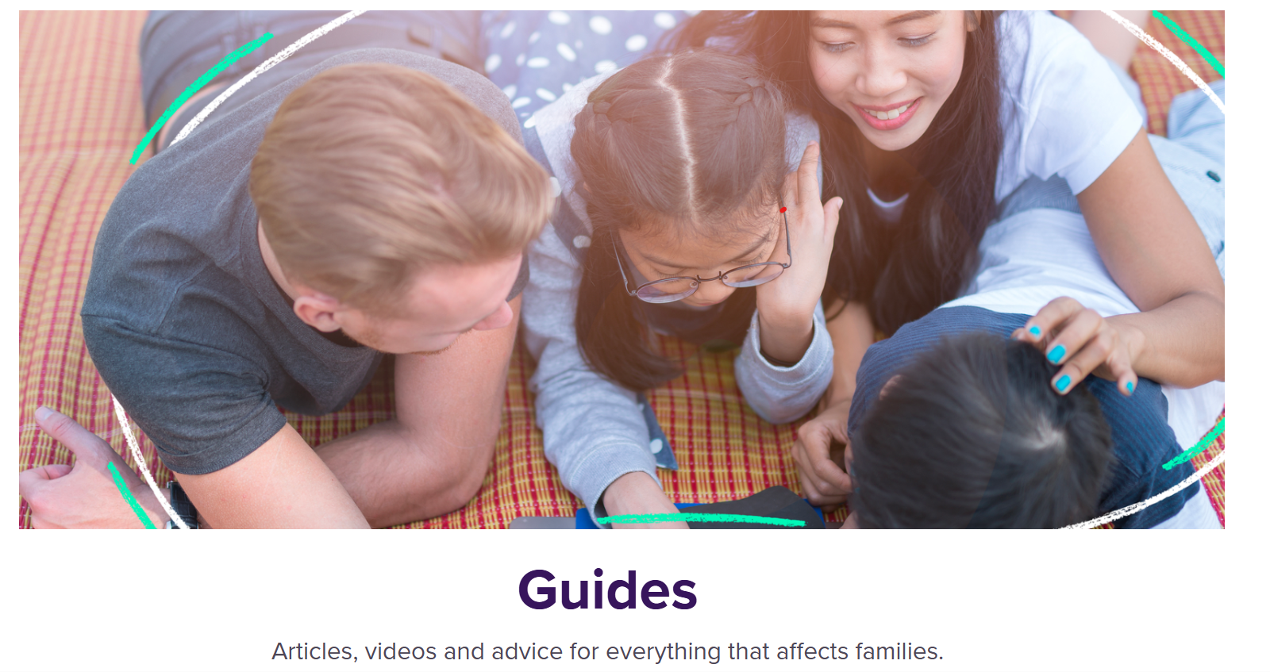

Block content on YouTube

Slide 69

Screen Time - Iphone
Settings
Screen time
  Downtime – schedule time away from the screen
  App limits – set time limits for apps
  Always allowed – choose apps you want at all times
  Content and privacy restrictions – block inappropriate content.

Slide 70

Blue Light Filters - Iphone
Enable blue light filtering on your iPhone or iPad:
Go to Settings of your iPhone or iPad
Go to Display & Brightness
In this section you will find the option to switch on the Night Shift feature – this feature filters out the blue light that disturbs your sleeping pattern

Slide 71

Blue Light Filters – Android
Settings
Display
Night Light
This Photo by Unknown Author is licensed under CC BY

Slide 72

iPhone
Restrictions:
lock certain functions of the device
hiding songs with explicit lyrics
preventing YouTube from running
  Without the four-digit passcode
This Photo by Unknown Author is licensed under CC BY-SA

Slide 73
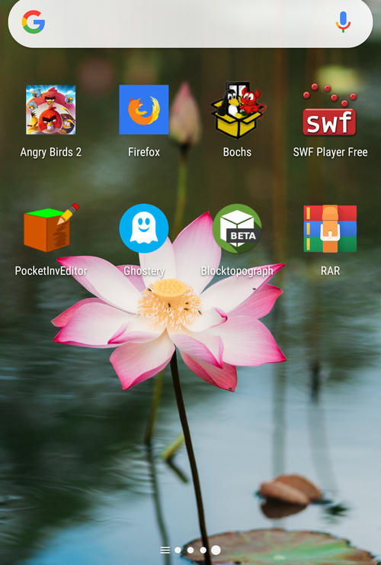
Android
Pull down from the top right
Tap on settings
Scroll down to set users
Add user or profile
Can create a normal user or a restricted profile.

Slide 74

Parental Control Apps
Qustodio
  Set rules and time
  Block unsuitable content
OpenDNS Family Shield
  Blocks inappropriate material
Kidlogger
  Tracks what is typed and websites visited
  Keeps a record of what is visited and any screengrabs
  Only covers one device
Zoodles
  Dedicated web browser that creates a walled garden

Slide 75
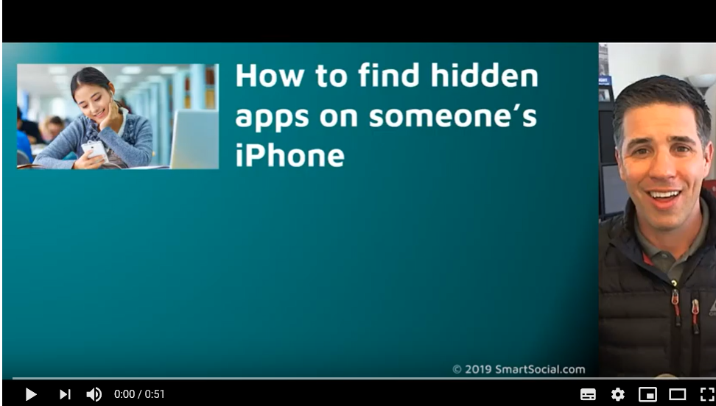
Hidden Apps

Slide 76
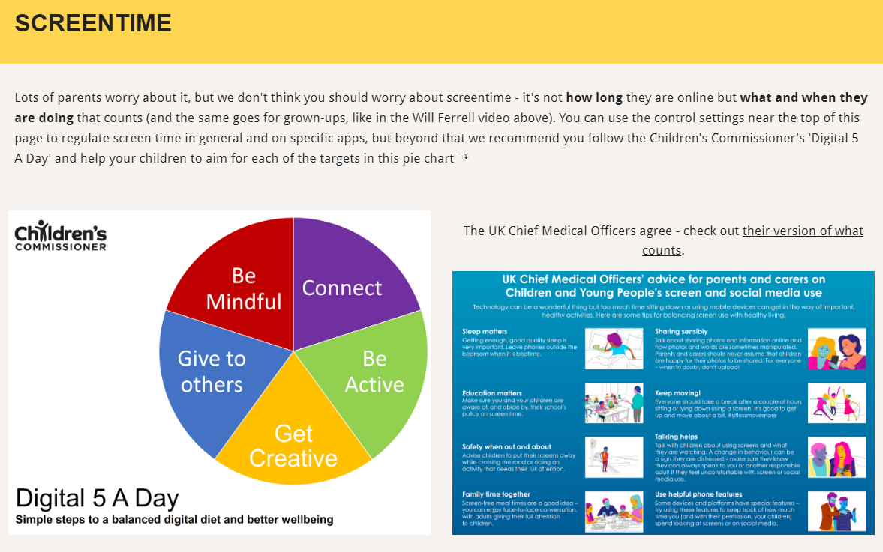
Visit parentsafe.lgfl.net/ for advice and tips to manage screentime
Notes:
ASK – Do you think lots of screentime is a bad thing generally? Why? How long is OK?
SHARE - World Health Organization (WHO) recommendations and research:
Infants (1 – 2 years) are recommended no screentime, whilst for 2 – 4-year-olds sedentary screen time should be no more than 1 hour; less is better.
When sedentary, engaging in reading and storytelling with a caregiver is encouraged
Improving physical activity, reducing sedentary screen time and ensuring quality sleep in young children will improve their physical, mental health and wellbeing, and help prevent childhood obesity and associated diseases later in life.
TELL – It’s not how long they are online but what and when they are doing that counts - take them through the UK Chief Medical Officer’s advice poster above for examples
EXPLAIN – the Digital 5 A day gives children and parents easy to follow practical steps to achieve a healthy well balanced digital diet, by encouraging them to reach of the targets in the pie chart – share some examples with them https://www.childrenscommissioner.gov.uk/digital/5-a-day/

Slide 77
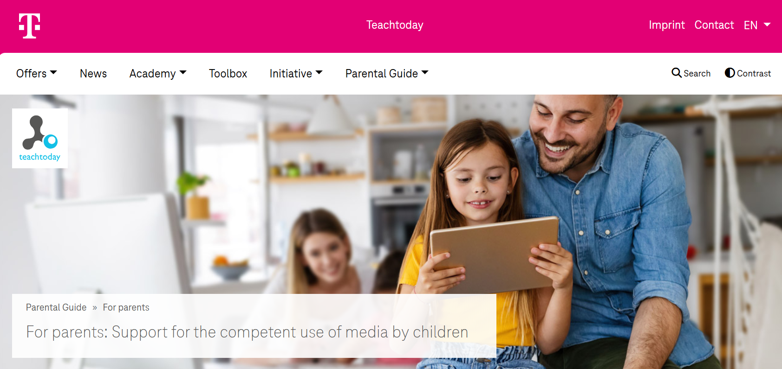
Parental Guide > For parents | Teachtoday

Slide 78

To Enable You Tube Safety Mode
1. Log in to your Google or Youtube account.
2. Go to the YouTube.com site in your web browser.
3. Click on the "Safety" button near the bottom of the YouTube homepage.
4. Click the "On" button. If you receive a message after clicking the on button that says "You can lock the Safety Mode setting after you sign in" then you are not logged into Google / YouTube. Click the "sign in" link if needed.
5. Check the box that says "Lock safety mode on this browser".
6. Click the "Save" button. After you've clicked the save button, the page you were on will reload and you will see a banner near the top of the page that shows a check mark with the words "Successfully enabled Safety Mode" next to it.
7. IMPORTANT!! In order to prevent your child from just turning safety mode off, you must log out of your Google / YouTube account by clicking your username link in the top right-hand corner of the browser window. This will effectively lock the setting in for the browser you are using, preventing your child from disabling Safety Mode. You will need to repeat this process for all other web browsers that are on your computer (i.e. Firefox, Safari, etc).
Enable YouTube Safety Mode on Your Mobile Device
Safety Mode may also be available on your mobile device's YouTube app. Check the settings area of the mobile app to see if it is an option. The process for locking the feature should be similar to the process above.
Setting Parental Controls on YouTube
https://www.youtube.com/watch?v=u00yKwGFpS0

Slide 79


Slide 80
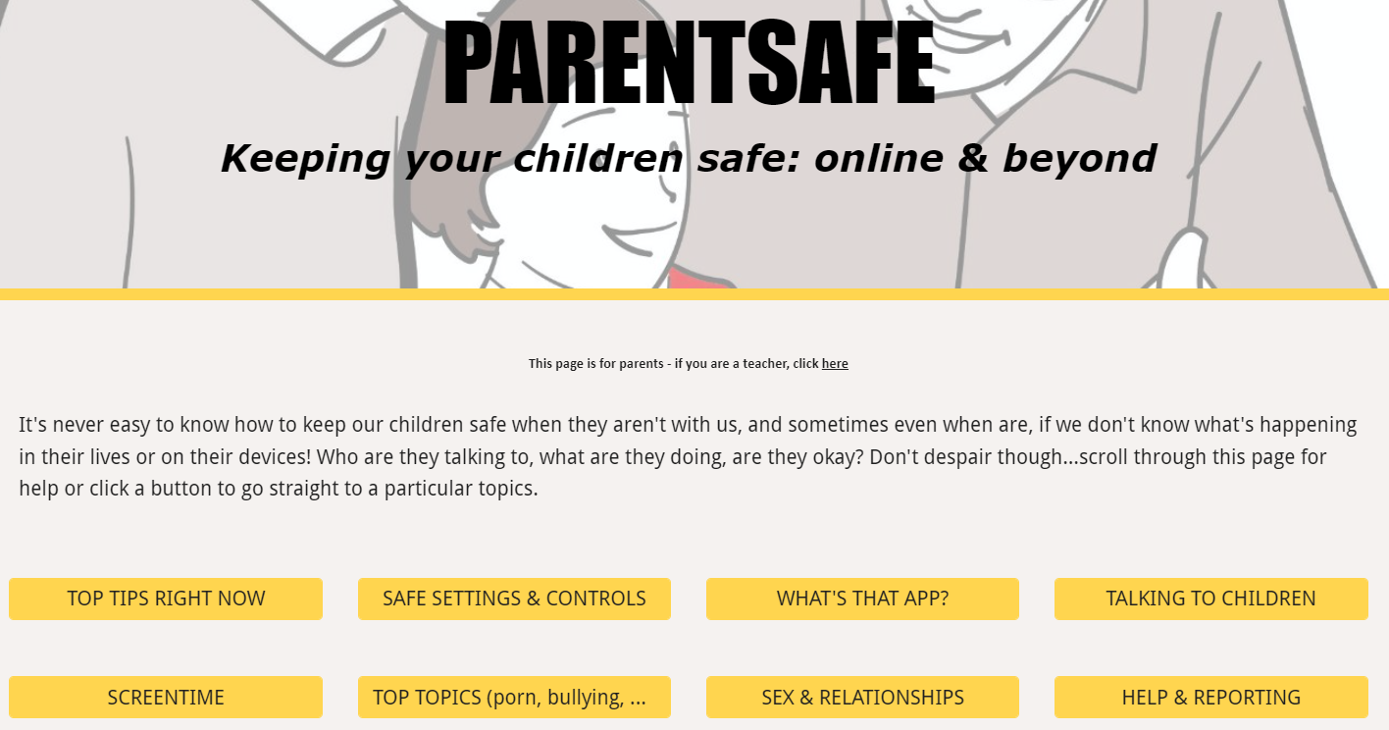
parentsafe.lgfl.net
Notes:
TELL - It's never easy to know how to keep our children safe, especially if we don't know what's happening in their lives or on their devices! Who are they talking to, what are they doing, are they okay? Don't despair though... We’ve created a dedicated website for parents and carers - simply scroll through ParentSafe for help or click a button to go straight to a particular topics. We will look at some of these resources and tips shortly

Slide 81




Notes:
Resources that can be used.
#Goldilocks: posts hilarious online videos. One day breaks into the bear’s house and posts her videos. Is found by Daddy bear due to her personal information online and is in trouble!
Troll stinks: Billy Goat and his best friend Cyril are messing about with the farmer's mobile phone, taking selfies and playing games... until they discover the number for a troll. Grandpa Gruff says all trolls are bad, so Billy and Cyril decide to get their own back by sending mean messages. After all, trolls really do stink! Don't they?
Chicken clicking: One night Chick hops onto the farmer's house and has a browse on his computer - CLICK - soon she's shopping online for the whole farm! But when she arranges to meet up with a friend she's made online, she discovers all is not as it seems...
Old Macdonald has a phone: Old Macdonald loves his phone: it helps him organise his farm. But when the animals each get one of their own, they are soon on their phones all day - "Here a tweet, there a chat, WhatsApping the farm cat" - and before they know it, no work is getting done!

Slide 82

Any Questions?
Any questions?

